Slide 1

V.I.K.I
Virtual Interactive kenotic intelligent
ADVANCE
HOME AUTOMATION SYSTEM
.
.
.
.
Control Light Voice Security
Student No : HH-14-46-12
Full Name : Abdul Majeed Mohammed Shiroz
Course : HND in Computing
Supervisor : T. Anis Saboordeen

Slide 2
ABSTRACT
Home automation is one of the major growing industries that can change the way people live.
The proposed system consists of a voice recognition, Arduino mega microcontroller, relay circuit to and an adjustable sensors.
People who live alone might also need a helping hand at
home.

Slide 3

CONTENTS
Introduction
Existing System
Drawback
Proposed System
Components
Aims & Objective
Artifact
Development Components
Development Tool
Prototype
Software Design
Summary

Slide 4

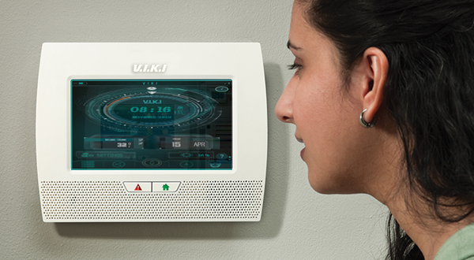
INTRODUCTION
“Advance Home Automation System via
Voice interaction”
The home automation systems are gaining popularity day by day. Integrating voice recognition technology to home automation systems make the system more user friendly and easy to operate. Some require home automation system to satisfy their needs and comfort while for physically challenged people it can provide great assistance.

Slide 5

WHY HOME AUTOMATION SYSTEM ??
Save time
Save Money (long run)
Self maintenance
Security
Safe & Make life easier

Slide 6
EXISTING SYSTEM
Now a days, there’re lot of technology available for home
automation. Each technology gives different benefits.
Apart from that Home automation is most common
functions done by that particular system.
In solution such as Voice recognition & smart responses,
Easy to fix, more flexible and comfortable to use and
much more…

Slide 7
SYSTEM DRAWBACKS
The system is directly installed beside the conventional electrical switches on the wall.
The target home appliances are controlled by the system Main Control Board.
System provides two types of control methods to the Main Control Board.
The feature will be add wireless connection enabled system communicates with graphical user interface (GUI) on PC/laptop or smart phone without cable.

Slide 8
PROPOSED SYSTEM
In order to achieve the objective of this project, there
are several scope had been identified.
The scope of this project includes the designing of a
voice recognition software for the voice recognition
purpose.
Follow by the designing of the microcontroller board
using Arduino as the hardware that control the whole
system by V.I.K.I software.

Slide 9

COMPONENTS
What are the main components of this system?
Arduino Mega board
Sensors
Motors
Lights & Fans
Model House structure

Slide 10

AIMS & OBJECTIVE
Low cost solution
Voice Controlling
V.I.K.I Interface
User-friendly
Customize system by the user
Test the developed system
Managing the proposed project efficiently to meet the targets.

Slide 11
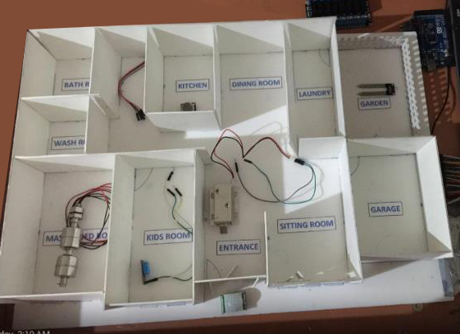
ARTIFACT
  Hardware design with model house

Slide 12
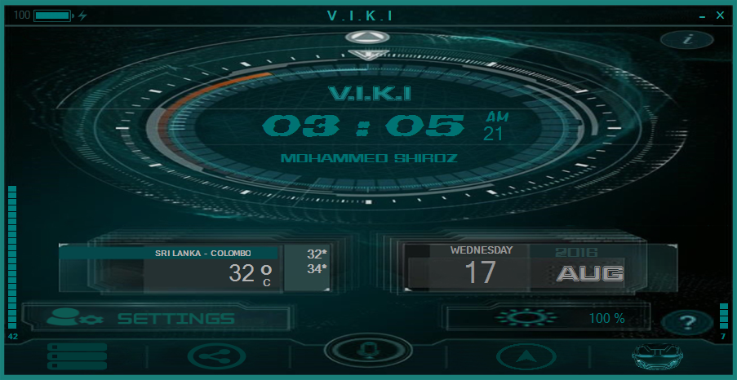
ARTIFACT cont..
  V.I.K.I (Software Interface)

Slide 13
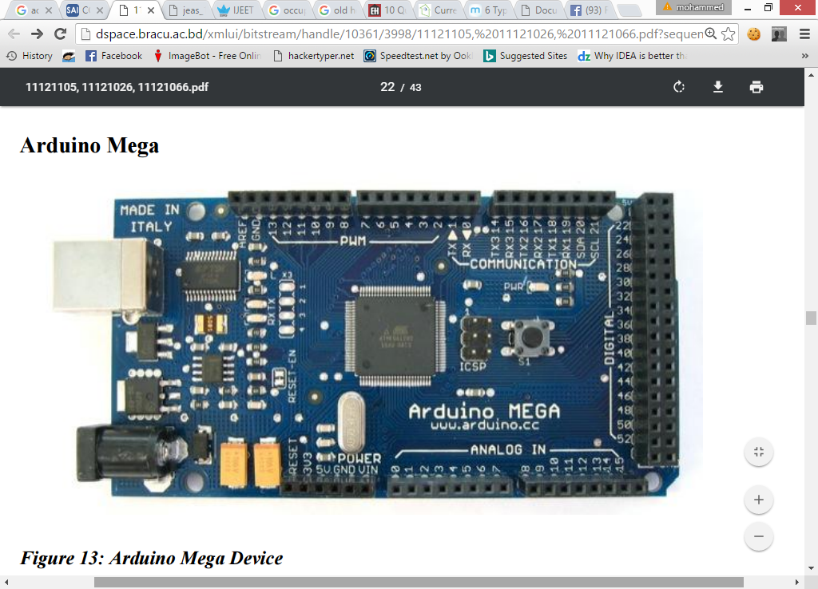
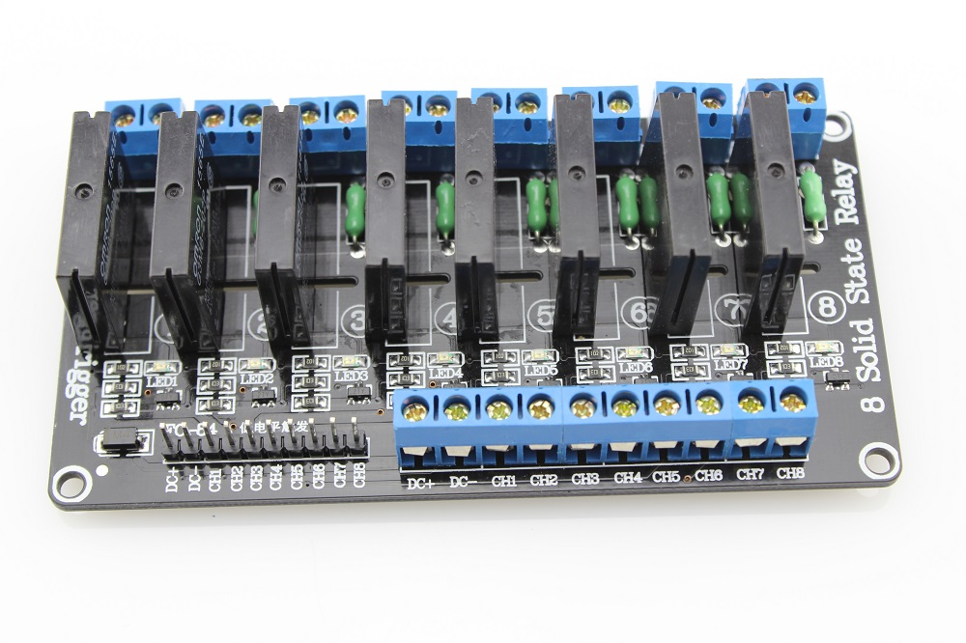
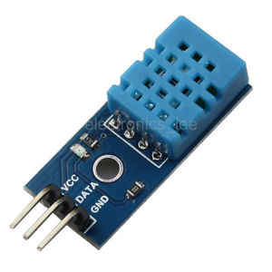
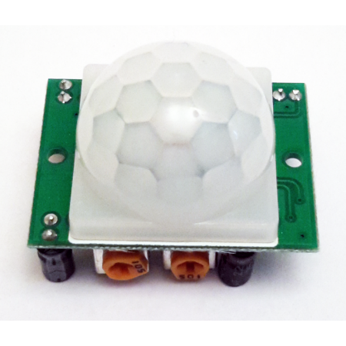
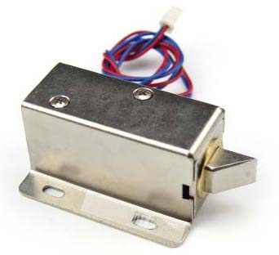
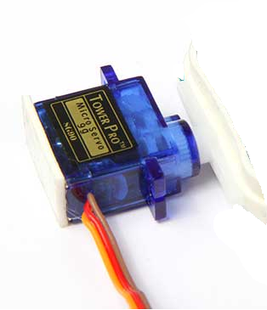
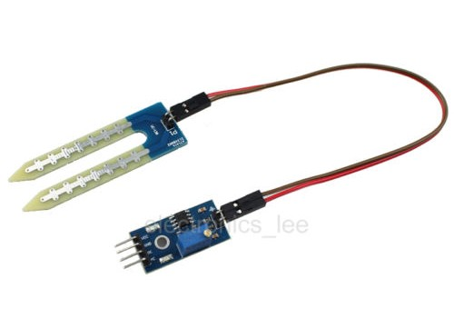
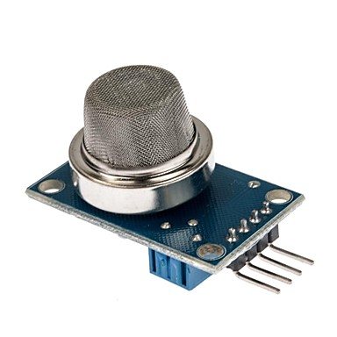
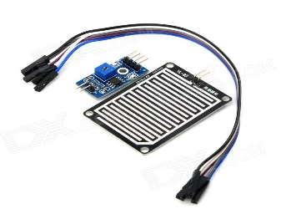
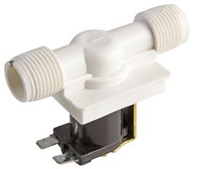
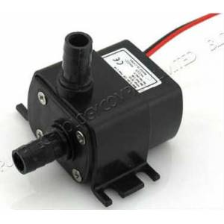
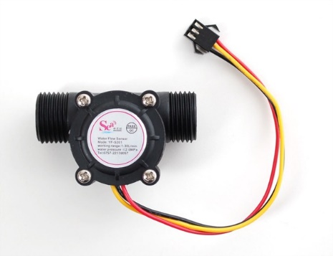
COMPONENT USED
Arduino Board
Solid Relay Board
Temperature Sensor
PIR Sensor
Solenoid Door Lock
Server Motor
Soil Sensor
Gas Sensor
Drain drop Sensor
Solenoid Valve
Water plumb
Water flow Sensor

Slide 14


DEVELOPMENT TOOLS
Software Development
Tools: Arduino SDK Microsoft Visual Studio | Programming Languages: C# C/C++ Java
Components | Cost Rs.
Arduino Mega | 6,478.00
AM2302 temperature-humidity sensor | 2,115.00
LPG Gas Sensor | 697.00
PIR Sensor | 1,692.00
Solenoid – Door Clock | 1,833.00
Soil Sensor | 1,450.00
8 Solid Relay | 6,400.00
Shipping | 2,000.00
Server Motor | 250.00
Speaker / Buzzer | 50.00
LED | 20.00
Water pump | 6,750.00
Total Cost | 29,735.00
Cost
Estimation

Slide 15
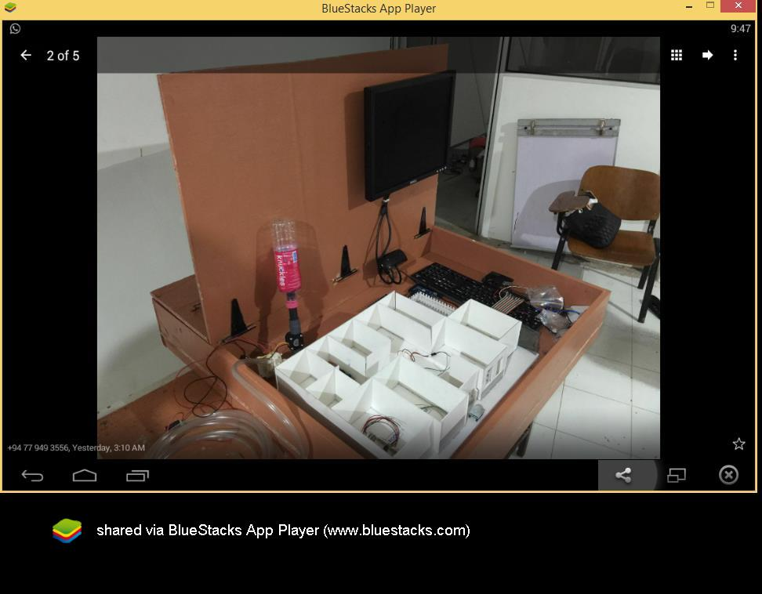
PROTOTYPE
Initial Prototype

Slide 16
PROTOTYPE cont..
Final Artifact

Slide 17
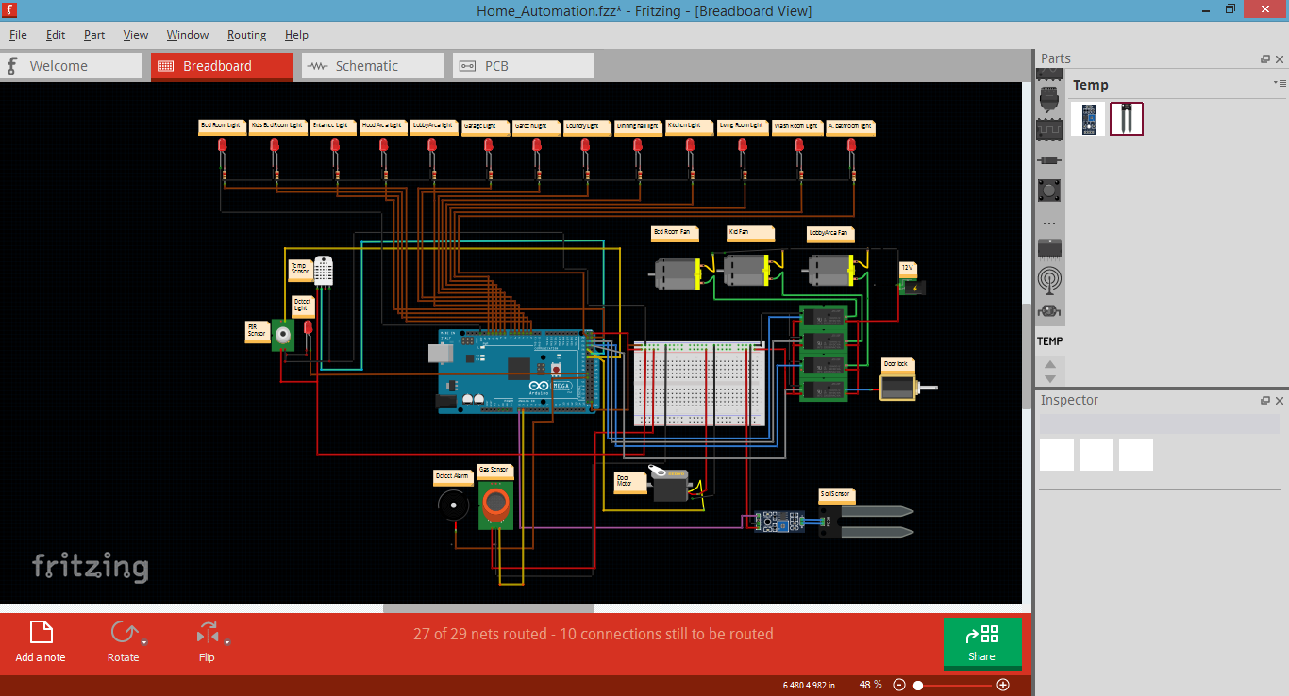
SYSTEM DESIGN
System Hardware diagram

Slide 18
SYSTEM DESIGN
System flow diagram

Slide 19
ADVANTAGES
Physically Challenged and Disabled People
Provide safety protection to the user,
Low voltage activating switches is replaced current electrical switches.
The system is designed in user-friendly interface.
Low cost to design the system.
Ease of installation.
Smart Home

Slide 20
SUMMARY
This low cost system is designed to improve the standard living in
home.
People can control their electrical devices via these Home Automation
devices and set up controlling actions through voice command.
Flexible types of connections are designed as backup connections to
the system.
In future this product may have high potential for marketing.

Slide 21
QUESTION TIME
?
V.I.K.I
Virtual Interactive kenotic intelligent

Slide 22
Thank You
Present by : Mohammed Shiroz

